Slide 1
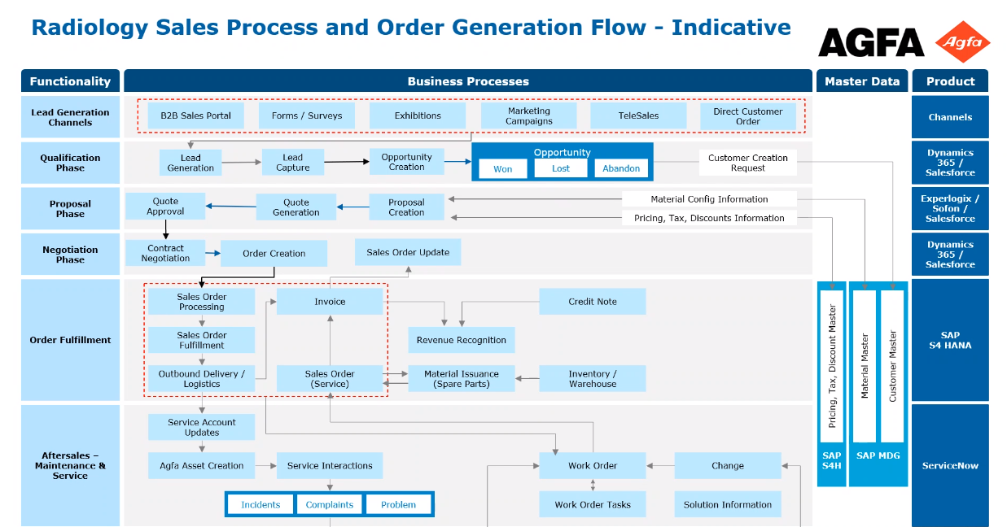

Slide 2
SalesOne & Sofon Interconnectivity
Radiology Solutions
2022.06.09
Jo-Mei Hsiao
Global Business Process Manager OG – Data Analyst

Slide 3
SalesOne & Sofon Interconnectivity
See slide 4
Master Data SAP (Pricebook)
Sales Funnel & Forecast SAP-BI
Opportunity SalesOne
Quotation Sofon
Sales Order
SAP ECC AP7
See
slide 5
See
slide 3

Slide 4
SalesOne <- Interconnectivity -> Sofon
When ?
Sofon quotation status set to “Ready for Approval” (Agfa internal approval)
Sofon quotation status reaches “Accepted” (= accepted by the customer)
What ?
Sofon automatically updates SalesOne’s Product families, their amounts by PF revenues, RevRec timing.
In addition:
When Sofon quote Accepted => Opportunity stage changes to “won” automatically
When Sofon quote Closed => Opportunity closed as “lost” (after 24hrs ‘cool off’ hours)
*Remark: It’s not recommended to select “Closed” in Sofon, unless it’s indeed the intention to completely close the deal, including to close the opportunity in SalesOne.
Until when ?
As soon as the quotation is sent successfully to SAP as an order, the interconnectivity mechanism for this quotation will be stopped completely.
The interconnectivity (between SalesOne and Sofon) will continue till when the Opportunity is closed. So, if an accepted quote needs a new version , don’t forget to first manually re-open its opportunity since that was closed by the acceptance of the previous version.

Slide 5
SalesOne <- Interconnectivity -> SAP-BI (BP5 server)
When ?
SAP-BI (BP5 server) is fed with SalesOne data in a daily basis
What ?
Opportunity number and name
Gross Amount, based on the PF codes
*remark: this is also the OIT amount comes from…
Sales Stage, e.g. Identifying, Quoting, WON, Other, etc.
RevRec timing
Until when ?
SalesOne opportunity is constantly synchronized with SAP-BI in a daily basis

Slide 6
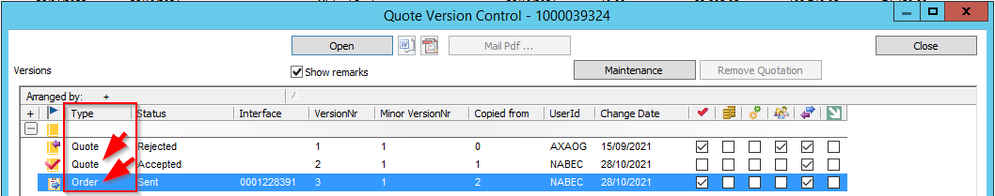
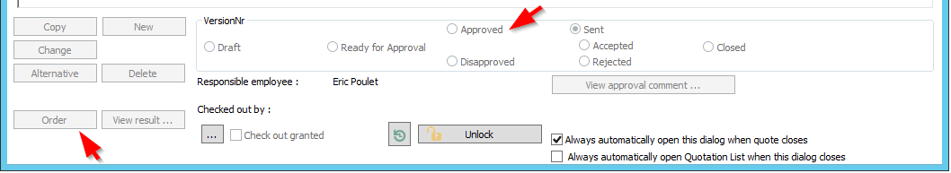
Sofon <- Interconnectivity -> SAP ECC (AP7)
When ?
“Order Type” Sofon Quotation status passed through Approved and click on the Order button
*Remark: noted that Sofon has “Quote type” and “Order type” configuration, only the Order Type configuration is sending to SAP ECC order.
What ?
ABC codes, PF, Net prices (Revenues), RevRec timing, billing milestones
Until when ?
Sofon Order Type configuration can be rejected and resent to SAP ECC orders multiple times without constrains.
When resend Sofon order to SAP order, the previous version SAP order should be cancelled manually in SAP ECC (AP7)

Slide 7
HE IMG Application Landscape (v.2)
Order Generation
SAP BI BP5
See slide 4
Sales Funnel/Reporting
SAP ECC AP7
Process Weaver
SalesOne SQL
SAP CRM CP7
Contacts Sales
Materials
Contacts
Customers
Vendors
Stream-liner
Contacts
Manual
order entry
(direct SAP)
Business Partners
SAP SD
Prospects
Customers
SO
Invoice
SAP
Pricebook
ServiceNow
Internet Sales
(B2B)
SAP AP1
(Peisenberg)
Customers
Opportunities
Contracts
SAP MM
SAP SCM PP6
WM/IM
MRP
PR
PO
Essers
Sofon SQL
Agfa Assets
EH&S
Quotes
CIs
Servigistics
SAP AP2
Greece
SAP PS
Incidents
PS
Project Portal
WM
Complaints
CATS
DBH Customs
Sugar CRM
SalesOne
SOFON
Work Orders
SAP FICO
See
slide 3
See
slide 5
Parts Stock
GHRIS
Mini Master
AP
AR
GL
AA
T&E
SAP CFIN
FCC
Victor
Hansa
Orga
OIT direct impacted lines

